Slide 1


Spoke-Darts for High-Dimensional Blue-Noise Sampling
Scott A. Mitchell ACM TOG 37:2, May 2018 Scott A. Mitchell, Mohamed S. Ebeida, Muhammad A. Awad, Chonhyon Park, Anjul Patney, Ahmad A. Rushdi, Laura P. Swiler, Dinesh Manocha (now UMD), Li-Yi Wei
SIGGRAPH 2018 18 minutes talk 15 Aug 10:45 am West Building, Room 109-110

Slide 2
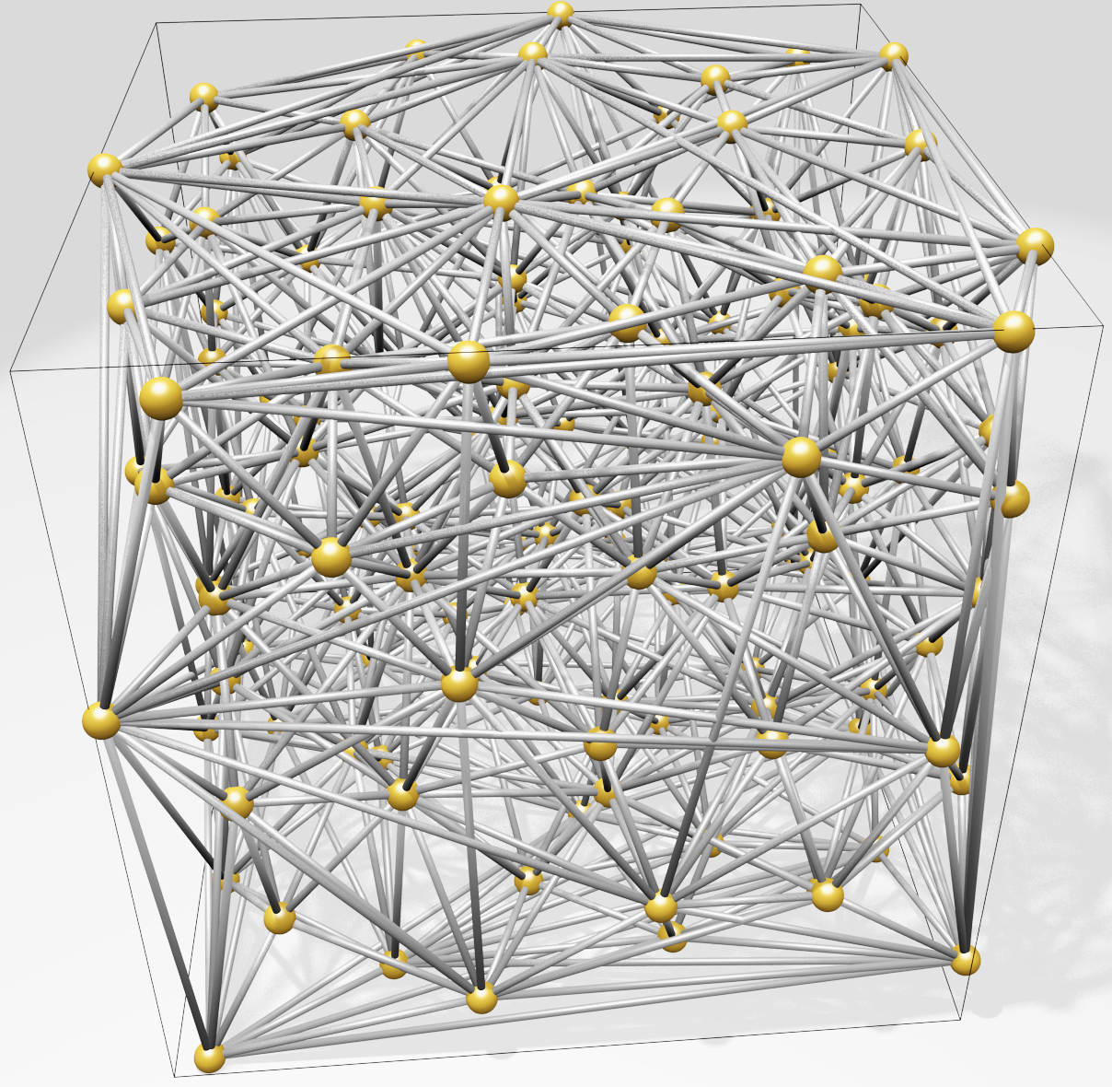
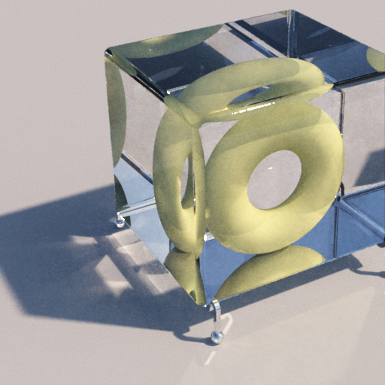
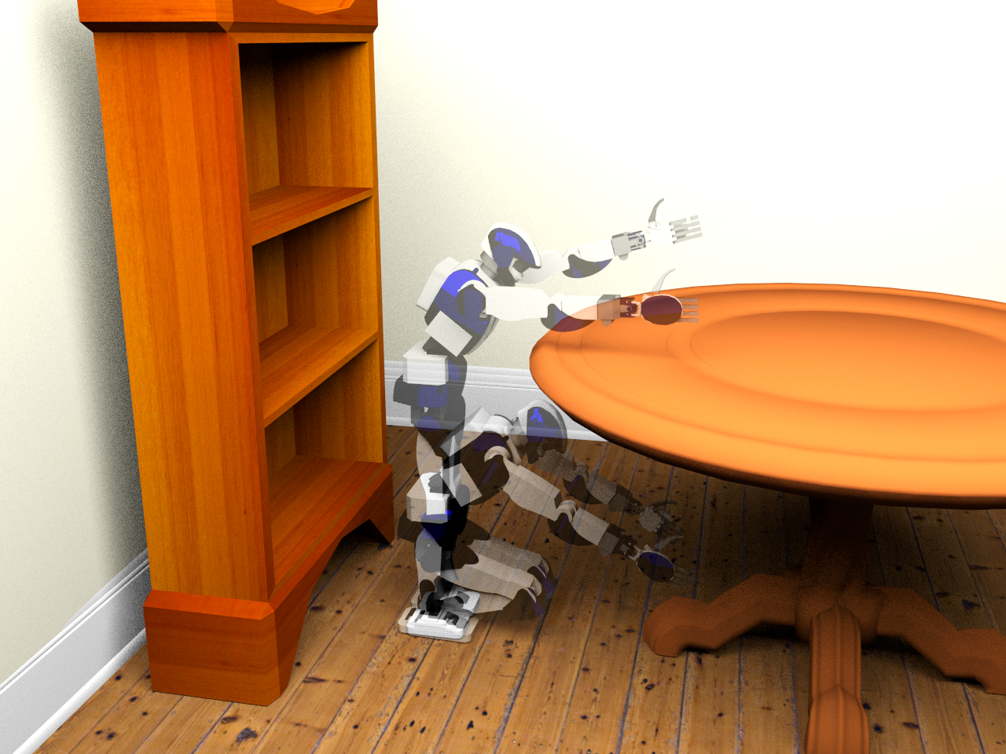
Motivation
High-dimensional blue-noise sampling is useful but hard to generate especially adaptively!
Render
Geometry
8-100D: approximate Delaunay Graphs (Voronoi neighbors)
8D: proof-of-concept path tracing
Social proof of utility: Bridson SIGGRAPH 2007 cited 200 times
23D: find a path in robot configuration space
Motion Plan
Optimize
100D: adaptively explore black-box function to find global minimum

Slide 3
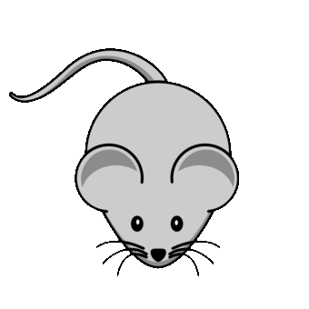
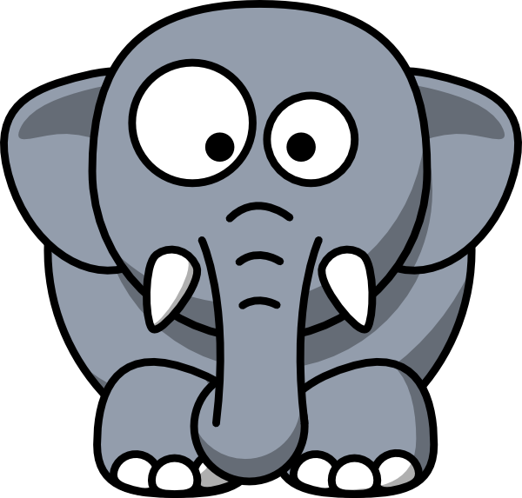
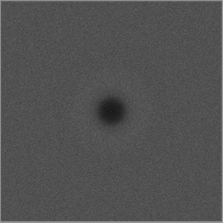
Motivation
Maximum
domain-to-sample distance
Goal: algorithm to produce point distributions
Requirements
Output: blue-noise, uniform-random point distribution except
No points too close
No big gaps
Process
Memory & time scales well to high dimensions (e.g. 20D)
Locally adaptive, general domain shapes
Confidence: provable guarantees on output quality
Goal: algorithm to produce point distributions
Requirements
Output: blue-noise, uniform-random point distribution except
No points too close
No big gaps
Process
Memory & time scales well to high dimensions (e.g. 20D)
Locally adaptive, general domain shapes
Confidence: provable guarantees on output quality
Goal: algorithm to produce point distributions
Requirements
Output: blue-noise, uniform-random point distribution except
No points too close
No big gaps
Process
Memory & time scales well to high dimensions (e.g. 20D)
Locally adaptive, general domain shapes
Confidence: provable guarantees on output quality
Goal: algorithm to produce point distributions
Requirements
Output: blue-noise, uniform-random point distribution except
No points too close
No big gaps
Process
Memory & time scales well to high dimensions (e.g. 20D)
Locally adaptive, general domain shapes
Confidence: provable guarantees on output quality
Minimum sample separation
RP Radial Power
RDF Radial Distance Function

Slide 4
What’s wrong with the algorithms we already have?
SimpleMPS guarantees saturation
runtime & memory
divide domain into cubes, diagonal length r while ∃cubes, and cube diagonal > machine precision do (A(d) × #cubes) times: pick a cube pick candidate sample from cube if distance(candidate, prior samples) > r accept candidate as sample discard cube refine remaining cubes discard covered cubes
darts
refine
darts
refine
SimpleMPS, “A Simple Algorithm for Maximal Poisson-Disk Sampling in High Dimensions,” Eurographics 2012.

Slide 5
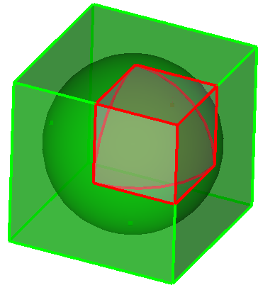
What’s wrong with the algorithms we already have?
SimpleMPS guarantees saturation … but doesn’t scale by dimension, d. ☹
runtime & memory
Problem: cube poorly approximates sphere Exponentially worse as dimension increases More empty boxes, memory limit d≈6
darts
…
refine
d=1
V(cube) = 1
V(sphere) = 1
d=2
V(cube) = 1
V(sphere) = 0.785…
d=3
V(cube) = 1
V(sphere) = 0.523…
d→∞
V(c) = 1
V(s) → 0
darts
Any algorithm that constructs (an approximation of) remaining sample space is doomed to be exponential-in-d
refine
SimpleMPS, “A Simple Algorithm for Maximal Poisson-Disk Sampling in High Dimensions,” Eurographics 2012.

Slide 6
What’s wrong with the algorithms we already have?
Bridson 2007* scales
runtime & memory
Front set = one sample do prior_sample = randomly pop Front do pick candidate from (r,2r) annulus around prior_sample if distance(candidate, all samples) > r accept candidate as sample add candidate to Front until 30 consecutive rejections until Front is empty
Bridson 2007 pseudocode, modified for exposition
30+ depending on dimension
*Modified to eliminate a background grid and exponential-in-d complexity.
Bridson 2007, "Fast Poisson disk sampling in arbitrary dimensions." SIGGRAPH '07 sketch.

Slide 7
What’s wrong with the algorithms we already have?
Bridson 2007* scales … but doesn’t guarantee saturation ☹
runtime & memory
Trivial bound on empty volume in one annulus.
Unknown if saturated outside all annuli?
?
Bridson 2007, "Fast Poisson disk sampling in arbitrary dimensions." SIGGRAPH '07 sketch.

Slide 8
Proposed algorithm
Spoke-Darts scales
runtime & memory
Front set = one sample do prior_sample = randomly pop Front do pick candidate from radial line through (r,2r) annulus around prior_sample if distance(candidate, all samples) > r accept candidate as sample add candidate to Front until 12 consecutive rejections until Front is empty
Spoke-Darts change from Bridson in red
12 same for all dimensions
O
Spoke-Darts for High-Dimensional Blue-Noise Sampling, TOG 72:2, SIGGRAPH 2018.

Slide 9
Proposed algorithm
Spoke-Darts scales … and guarantees saturation ☺
runtime & memory
Provable bound on size of a void outside all annuli!
!
Spoke-Darts for High-Dimensional Blue-Noise Sampling, TOG 72:2, SIGGRAPH 2018.

Slide 10
Suppose there is void outside all disks
Proof of saturation
Spoke-Darts scales … and guarantees saturation
One disk
Missed 12 times, so area is probably small, R = area(shared) / area(disk)
i.e. Probability of 12 misses = 𝝥 (1-R)¹² < e^{(-12R)}
All disks Probability all missed = product of probabilities
p = 𝚷 e^{(-12 R_i)} = e^{-12 𝚺 R_i}. So area sum is small.
Small surface area → small void radius
No big gaps!

Slide 11
Structure of saturation guarantee
Magic values for dimensional independence
e.g.
where
e.g.
chance beta exceeded
#misses, failed candidates
dimension
you get to pick any three

Slide 12
Output Saturation in Practice
Output Saturation in Practice,= better than Bridson
Beta Spoke-Darts(d) ≈ Bridson(d-1) one dimension of saturation “for free”
Theory: Beta = constant
Practice: Beta varies with d
Increases (but converges for high d?)
Distribution narrows, consistent with theory
Spoke-Darts
dimension = 2
3
4
5
6
Bridson

Slide 13
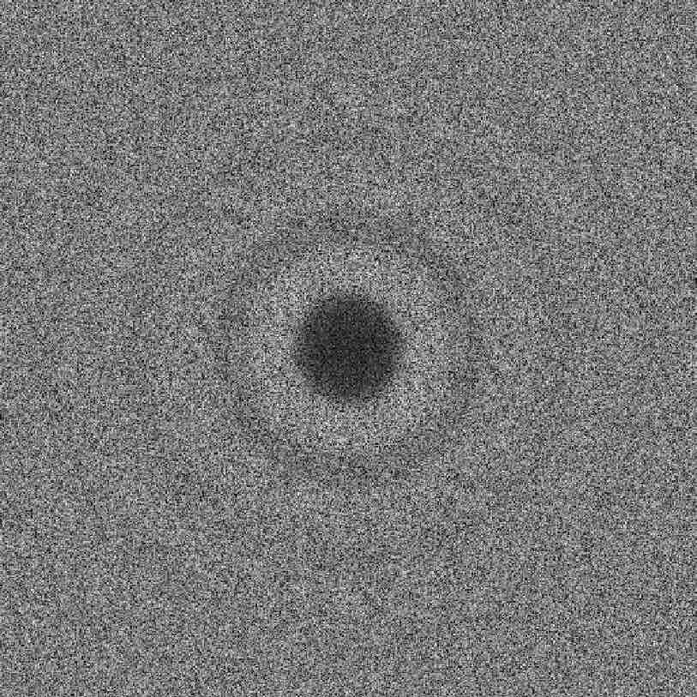
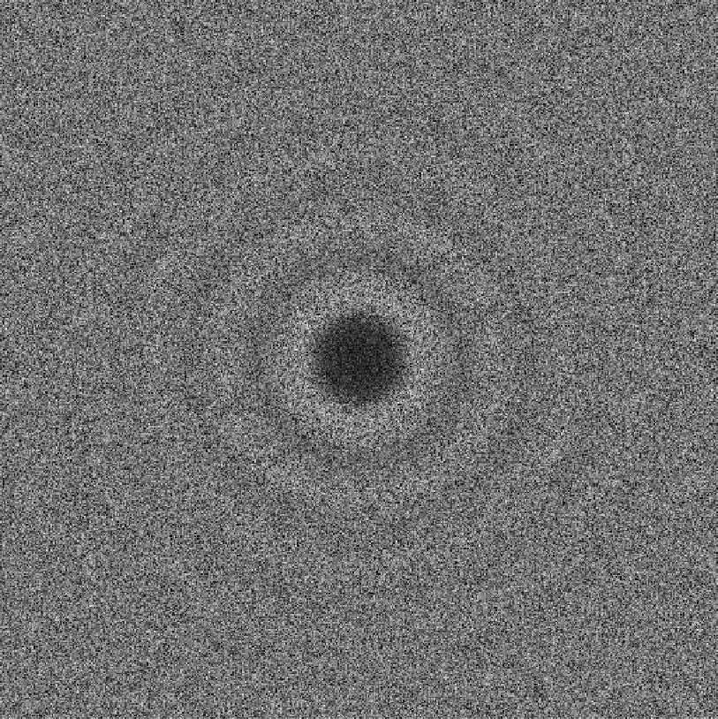
Output Randomness – Blue noise
All these have sharp spike at annuli inner-radius!
d=2
Dart Throwing
Spoke-Darts
Pairwise distances between samples
Bridson 2007
2nd discontinuity annuli outer-radius
Dart throwing images from
Blue Noise Sampling with Controlled Aliasing, TOG 32:3, 2013.
Fourier Transform, 1d integral over angle by radius
Fourier Transform

Slide 14
Output Randomness – Blue noise
Eliminate the spike
Post-processing optimization* = expensive
Sample non-uniform by spoke-length?
Made things worse! Any sharp local rule → global discontinuity ☹
Spoke-Darts
* Blue Noise Sampling with Controlled Aliasing, TOG 32:3, 2013.

Slide 15
Output Randomness – Blue noise
Eliminate the spike – we solved this in 2012 ☺
Two-radii sampling †
Small blue minimum sample separation
Large red maximum domain-to-sample
Unique coverage: accept candidate only if it’s red disk covers uniquely
Two-spokes mimic Two-radii
Spoke-Darts
accept, red covers some white
reject, inside a blue disk
reject, red already covered
† Variable Radii Poisson-Disk Sampling, CCCG 2012.

Slide 16
Output Randomness – Blue noise
Eliminate the spike – we solved this in 2012 ☺
Two-radii sampling †
Small blue minimum sample separation
Large red maximum domain-to-sample
Unique coverage: accept candidate only if it’s red disk covers uniquely
Two-spokes mimic Two-radii
Spoke-Darts
† Variable Radii Poisson-Disk Sampling, CCCG 2012.

Slide 17
Proposed algorithm: Two-Spokes for Soft Blue Noise
Animate algorithms

Slide 18
Output Quality
Two-spokes – show flat rdf and rp and spectra
Price is b=4 not 2
Price is longer runtime, larger radius relative to minimum distance
Show spectra of true two-radii

Slide 19
Runtime
d
Linear scaling is perfect: primitives are O(d)
n²
Finding neighbors in high dimensions expensive
Might have n² neighbors regardless of speed of finding them
Spoke-Darts ≈ Bridson 2007 due to simple primitives
Point in sphere?
Trim segment by sphere
Runtime( Two-Spokes ) > Runtime( One-Spoke )
mostly due to 2 × radius of annulus, many more neighbor disks

Slide 20
Conclusions
Free software
SpokeDartsPublic on github: https://github.com/samitch/SpokeDartsPublic
Want high-d blue noise?
Use spoke-darts line sampling
Supports adaptive sampling over general domains
Nearly as easy to implement (especially since I already did that for you :) and runs faster, than Bridson 2007
Want blue-noise with better spectrum?
Use two-spokes variant
Takes longer
Practical up to about 30d, depending on domain periodicity
Open problems
Prove non-trivial saturation-bound on Bridson 2007?
Does saturation matter for high-d rendering, etc.?

Slide 22
Proposed algorithm
Spoke-Darts scales … and guarantees saturation ☺
runtime & memory
Front set = one sample do prior_sample = randomly pop Front do pick candidate from radial line through (r,2r) annulus around prior_sample if distance(candidate, all samples) > r accept candidate as sample add candidate to Front until 12 consecutive rejections until Front is empty
Bridson 2007 pseudocode, modified for exposition
nada
Spoke-Darts for High-Dimensional Blue-Noise Sampling, TOG 72:2, SIGGRAPH 2018.

Slide 23
Proposed algorithm
Spoke-Darts scales … and guarantees saturation ☺
runtime & memory
Front set = one sample do prior_sample = randomly pop Front do pick candidate from radial line through (r,2r) annulus around prior_sample if distance(candidate, all samples) > r accept candidate as sample add candidate to Front until 12 consecutive rejections until Front is empty
Bridson 2007 pseudocode, modified for exposition
Spoke-Darts for High-Dimensional Blue-Noise Sampling, TOG 72:2, SIGGRAPH 2018.

